Slide 1


INFT 1012 Network Fundamentals
Week 12 – Topic Outline and Highlights

Slide 2
Topics
IPv6
The need for IPv6 addresses
IPv6 address representation
IPv6 address types
Configuration of IPv6 addresses
Design considerations for IPv6
ICMP and connectivity test
ICMP
Ping
Tracert/Traceroute

Slide 3
Readings
CCNAv7: Introduction to Networks course text & quizzes
Module 5 – Section 5.2 (Hexadecimal number system)
Module 12
Module 13
Available at: www.netacad.com

Slide 4
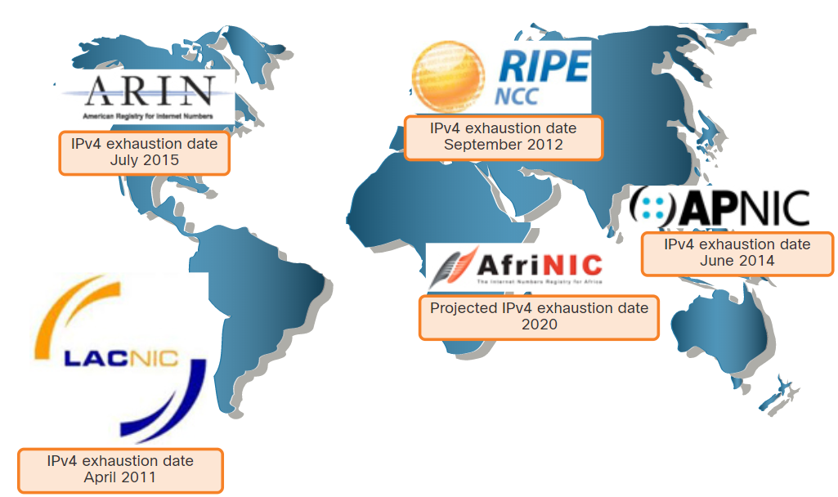
The Need for IPv6, Coexistence of IPv4 & IPv6
Reason for IPv6: an increasing Internet population, a limited IPv4 address space, issues with NAT, increase of mobile devices, Internet of Things.
IPv6 standard came out in 1990s, but the transition is not simply replacing IPv4 addresses with IPv6 addresses. we are still in the stage of transitioning from IPv4 to IPv6 and they may coexist for a long time.
The migration techniques can be divided into three categories:
Dual stack
Tunneling
Translation

Slide 5
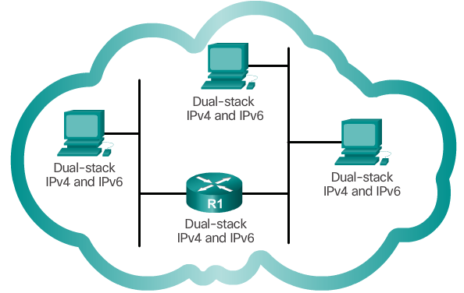
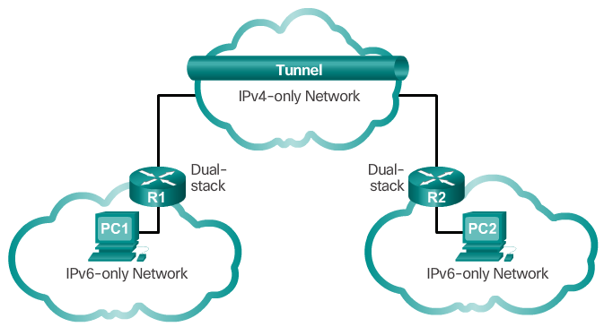
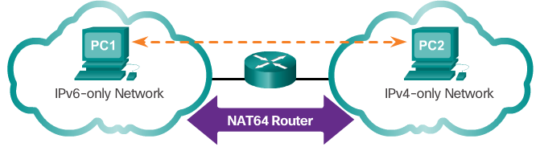
IPv4 and IPv6 Coexistence
Dual-stack allows IPv4 and IPv6 to coexist on the same network. Devices run both IPv4 and IPv6 protocol stacks simultaneously.
Tunneling is a method of transporting an IPv6 packet over an IPv4 network. The IPv6 packet is encapsulated inside an IPv4 packet.
Translation: Network Address Translation 64 (NAT64) allows IPv6-enabled devices to communicate with IPv4-enabled devices using a translation technique similar to NAT for IPv4. An IPv6 packet is translated to an IPv4 packet, and vice versa.

Slide 6
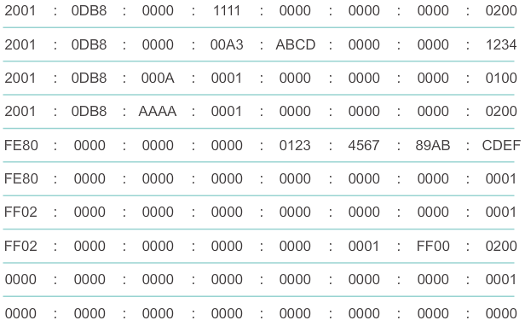
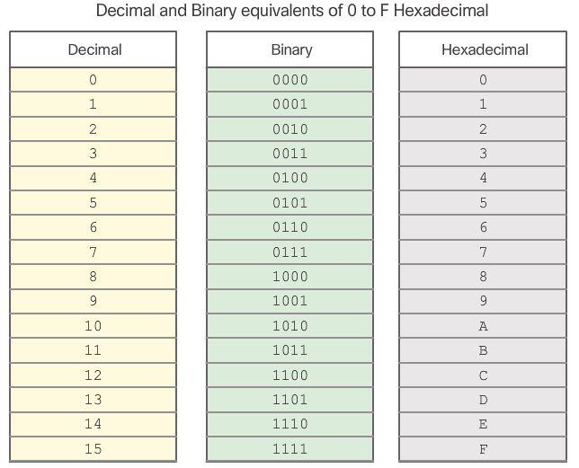
IPv6 Address Representation
An IPv6 addresses are 128 bits in length
As every 4 (binary) bits can be represented by a single hexadecimal digit → An IPv6 address contains 32 hexadecimal digits
Every 4 hexadecimal digits are grouped into 1 hextet
→ An IPv6 address contains 8 hextets, separated by “:”
Such a “full” representation of an IPv6 address with 8 hextets separated by “:” is known as the preferred format.

Slide 7
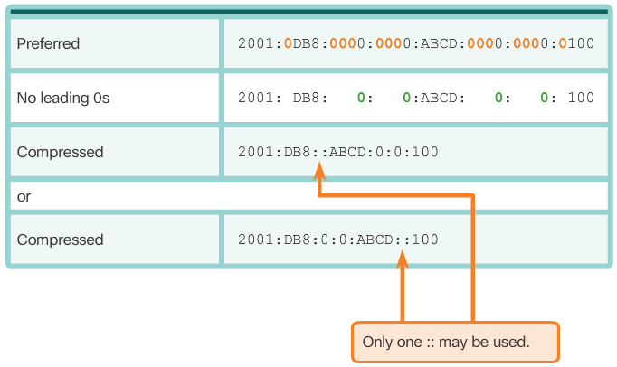
IPv6 Address Representation – compressed format
Rule 1: Omit leading 0s in each hextet
Rule 2: Omit 0 segments (hextets)
use a double colon “::” to replace any single or more contiguous hextets consisting of all 0s.
Note: The “::” can only be used once within an address, otherwise there would be more than one possible resulting address.
If use “::” twice, we get:
2001:DB8::ABCD::100
Then there are more than one way to expand this, for example,
2001:DB8:0:ABCD:0:0:0:100
2001:DB8:0:0:ABCD:0:0:100
2001:DB8:0:0:0:ABCD:0:100
where only the second one is correct.

Slide 8
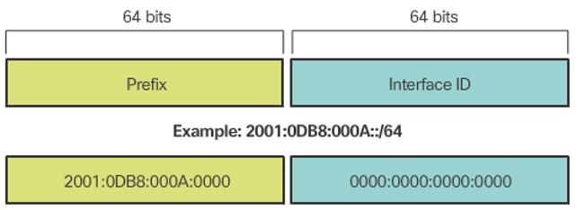
IPv6 Prefix Length
IPv6 does not use the dotted-decimal subnet mask notation.
Instead, it uses prefix length to indicate the network portion of an IPv6 address with the following format:
IPv6 address /prefix length
Prefix length can range from 0 to 128
Typical prefix length is /64

Slide 9
IPv6 Address Types
There are three types of IPv6 addresses:
Unicast
Multicast
Anycast
IPv6 does not have broadcast addresses, but there is an IPv6 all-nodes multicast address that essentially gives the same result
Usage of the different types of addresses:
A packet sent to a unicast address is received by the interface that is assigned that address.
Similar to IPv4, a source IPv6 address must be a unicast address.
The destination IPv6 address can be either a unicast or a multicast address.
Notes:
There are three types of IPv6 addresses:
Unicast - An IPv6 unicast address uniquely identifies an interface on an IPv6-enabled device. A source IPv6 address must be a unicast address.
Multicast - An IPv6 multicast address is used to send a single IPv6 packet to multiple destinations. have the prefix FF00::/8.
Anycast - An IPv6 anycast address is any IPv6 unicast address that can be assigned to multiple devices. A packet sent to an anycast address is routed to the nearest device having that address. Anycast addresses are beyond the scope of this course.
Unlike IPv4, IPv6 does not have a broadcast address. However, there is an IPv6 all-nodes multicast address that essentially gives the same result.

Slide 10
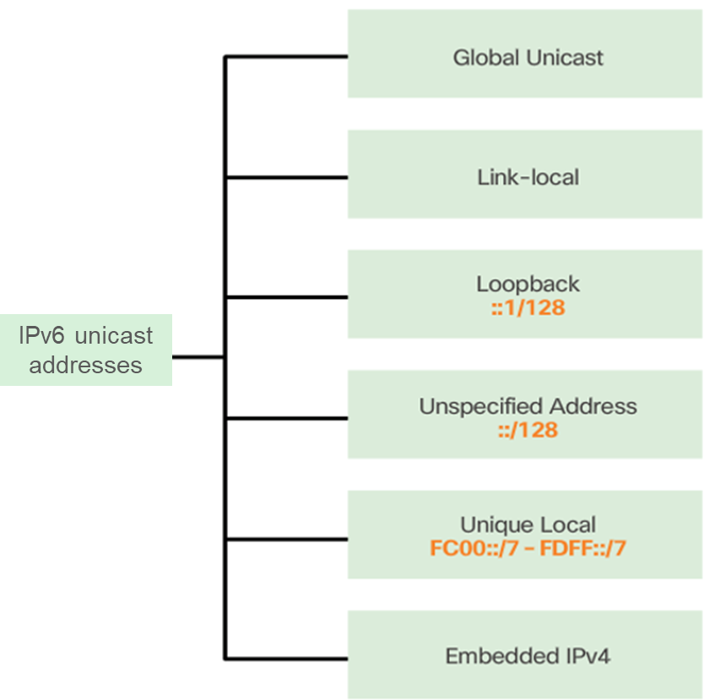
IPv6 Unicast Addresses
The most common types of IPv6 unicast addresses are global unicast addresses and link-local unicast addresses
Link-local addresses are used to communicate with other devices on the same local link
With IPv6, the term link refers to a subnet. Link-local addresses are confined to a single link.
Routers will not forward packets with a link-local source or destination address
A global unicast address is similar to a public IPv4 address.
globally unique, Internet routable addresses.
can be configured statically or assigned dynamically.

Slide 11
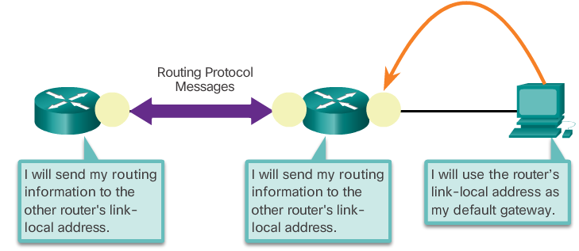
IPv6 Link-Local Unicast Addresses
Link-local address enables a device to communicate with other IPv6-enabled devices on the same link (subnet) and only on that link
Every IPv6-enabled network interface is required to have a link-local address
If a link-local address is not configured manually on an interface, the device will automatically create its own without communicating with a DHCP server
Link-local addresses are in the FE80::/10 range
The /10 indicates that the first 10 bits are 1111 1110 10xx xxxx. The first hextet has a range of 1111 1110 1000 0000 (FE80) to 1111 1110 1011 1111 (FEBF)
Typically, it is the link-local address of the router and not the global unicast address, that is used as the default gateway for other devices on the link

Slide 12
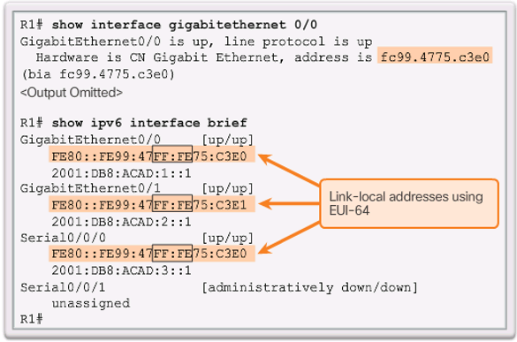
IPv6 Link-Local Unicast Addresses
Why Serial0/0/0 and G0/0 of R1 have exactly the same link-local address FE80::FE99:47FE:FE75:C3E0? Is this wrong?
No, this is not wrong. A link-local address must be unique only on that link or network. Serial0/0/0 and G0/0 are not in the same link or network, so their link-local addresses can be the same.

Slide 13
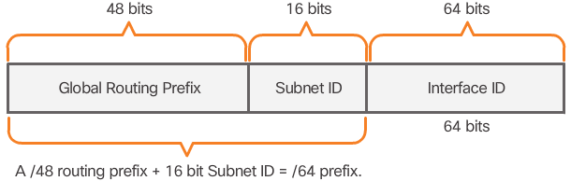
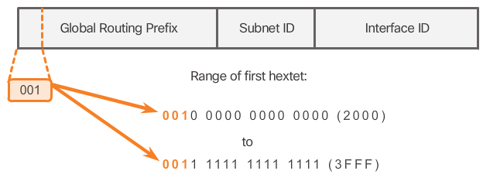
Structure of an IPv6 Global Unicast Address
The prefix or network, portion of the address that is assigned by the provider, such as an ISP, to a customer or site. A /48 global routing prefix is commonly used.
Equivalent to the host portion of an IPv4 address.
The subnet ID is used by an organization to identify subnets within its site. A 16-bit subnet ID is commonly used.
Currently, only global unicast addresses with the first three bits of 001 are being assigned. This is only 1/8th of the total available IPv6 address space, excluding only a very small portion for other types of unicast and multicast addresses.

Slide 14
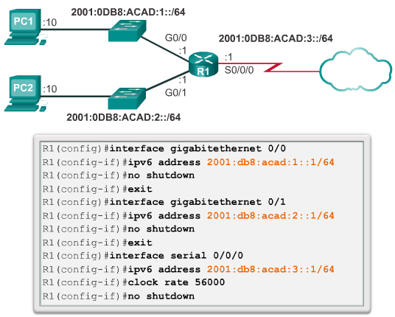
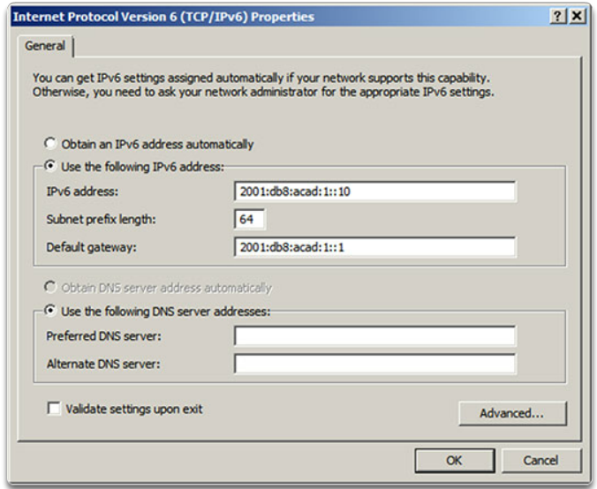
Static Configuration of a Global Unicast Address
Manually configuring the IPv6 address on a host is similar to configuring an IPv4 address.
*In this example, the default gateway address configured for the PC is 2001:DB8:ACAD1::1, the global unicast address of the router’s interface. Alternatively, the PC’s default gateway can be configured to be the link-local address of the router interface.
Configuring IPv6 on a router

Slide 15
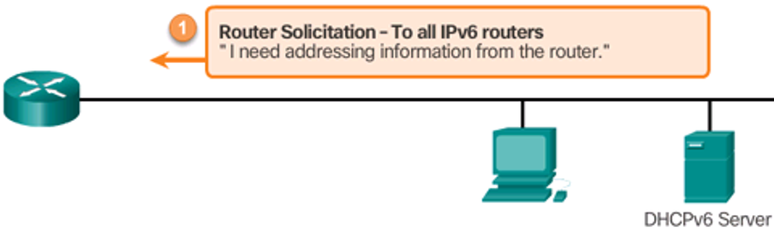
Dynamic Configuration of Global Unicast Address on Hosts
Dynamic configuration of IPv6 global unicast address on a host requires IPv6 router, and DHCPv6 server is optional.
Devices rely on the local IPv6’s router’s ICMPv6 Router Advertisement (RA) messages to obtain the necessary information, received periodically from the router or as response to a Router Solicitation (RS) message sent by the device.
How the dynamic IPv6 configuration is done for a device depends on the RA option the device receives
Router provides one of three options in an RA message:
Router Advertisement – to all IPv6 nodes
Option 1 SLAAC (Stateless Address Autoconfiguration) only – “Here is your prefix, Prefix-length, Default Gateway information”
Router Advertisement – to all IPv6 nodes
Option 2 SLAAC + DHCPv6 – “Here is your prefix, Prefix-length, Default Gateway information, but you need to get DNS info from a DHCPv6 server”
Router Advertisement – to all IPv6 nodes
Option 3 DHCPv6 only – “Use a stateful DHCPv6 server to obtain a global unicast address, DNS server address, domain name and all other information”

Slide 16
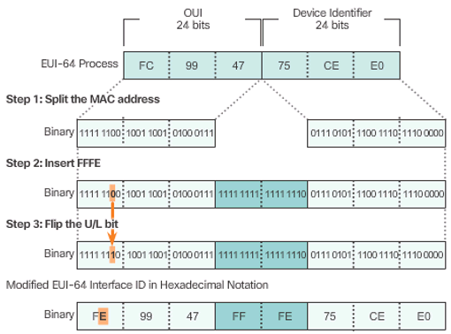
Generating Interface ID - EUI-64 vs. random generation
With Options 1 or 2, the client device needs to use the prefix info received in the RA message to generate its Interface ID. Two methods can be used:
EUI-64:
Step 1: Divide the MAC address between the OUI and device identifier.
Step 2: Insert the hexadecimal value FFFE (i.e. binary 1111 1111 1111 1110).
Step 3: Convert the first 2 hexadecimal values of the OUI to binary and flip the Universally/Locally bit (bit 7). In the example, the 0 in bit 7 is changed to a 1.
The result is an EUI-64 generated Interface ID of FE99:47FF:FE75:CEE0 in the example
Random generation:
As EUI-64 generated Interface IDs are based on MAC addresses, it has caused privacy concerns as packets may be traced to the actual physical computers.
A randomly generated Interface ID may be used instead, depending upon the operating system
For example, beginning with Windows Vista, Windows uses a randomly generated Interface ID instead of one created with EUI-64.

Slide 17
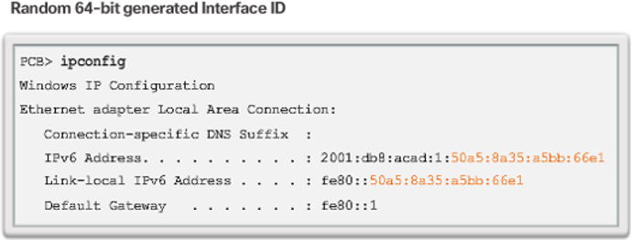
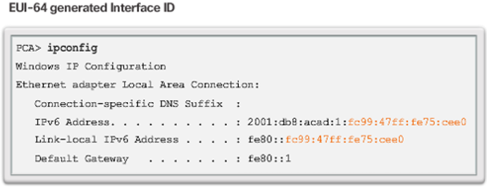
Dynamic Link-Local Addresses
Recall that Every IPv6-enabled network interface is required to have a link-local address, and if a link-local address is not configured manually on an interface, the device will automatically create its own without communicating with a DHCP server.
Operating systems will typically use the same method (either EUI-64 or random generation) for both a SLAAC created global unicast address and a dynamically assigned link-local address
Cisco routers automatically create an IPv6 link-local address whenever a global unicast address is assigned to the interface.

Slide 18
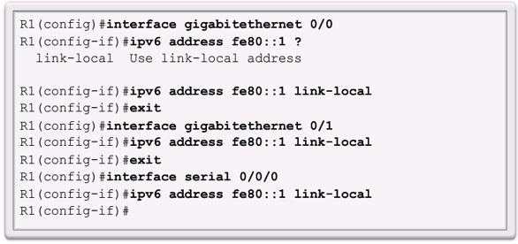
Static Link-Local Addresses
To make it easier to recognize and remember these addresses on routers, it is common to statically configure IPv6 link-local addresses on routers.

Slide 19
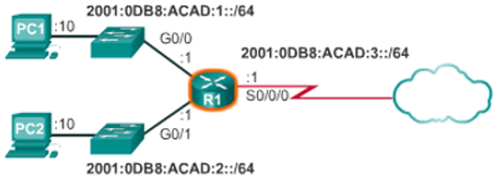
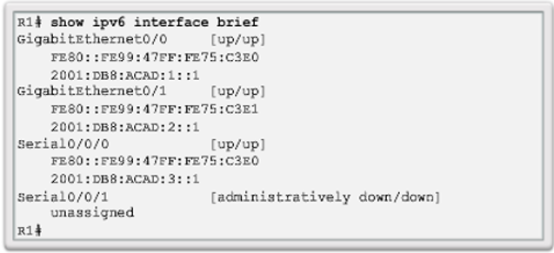
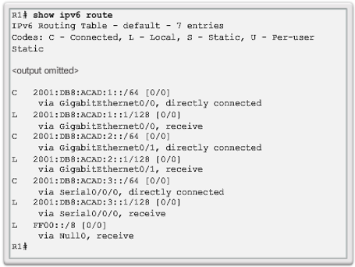
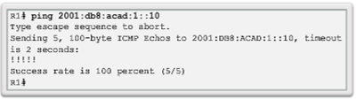
Verifying IPv6 Address Configuration

Slide 20
IPv6 Subnetting
IPv4 subnetting is not only about limiting broadcast domains but also about managing address scarcity.
IPv6 subnetting is about building an addressing hierarchy based on the number of subnetworks needed.
IPv6 subnetting is not concerned with conserving address space. The subnet ID includes more than enough subnets.
An IPv6 link-local address is never subnetted because it exists only on the local link.
However, an IPv6 global unicast address can be subnetted.
The 16 bit subnet ID section of the IPv6 global unicast address can be used by an organization to create internal subnets.
The subnet ID provides more than enough subnets and hosts than what would ever be needed in one subnet.

Slide 21
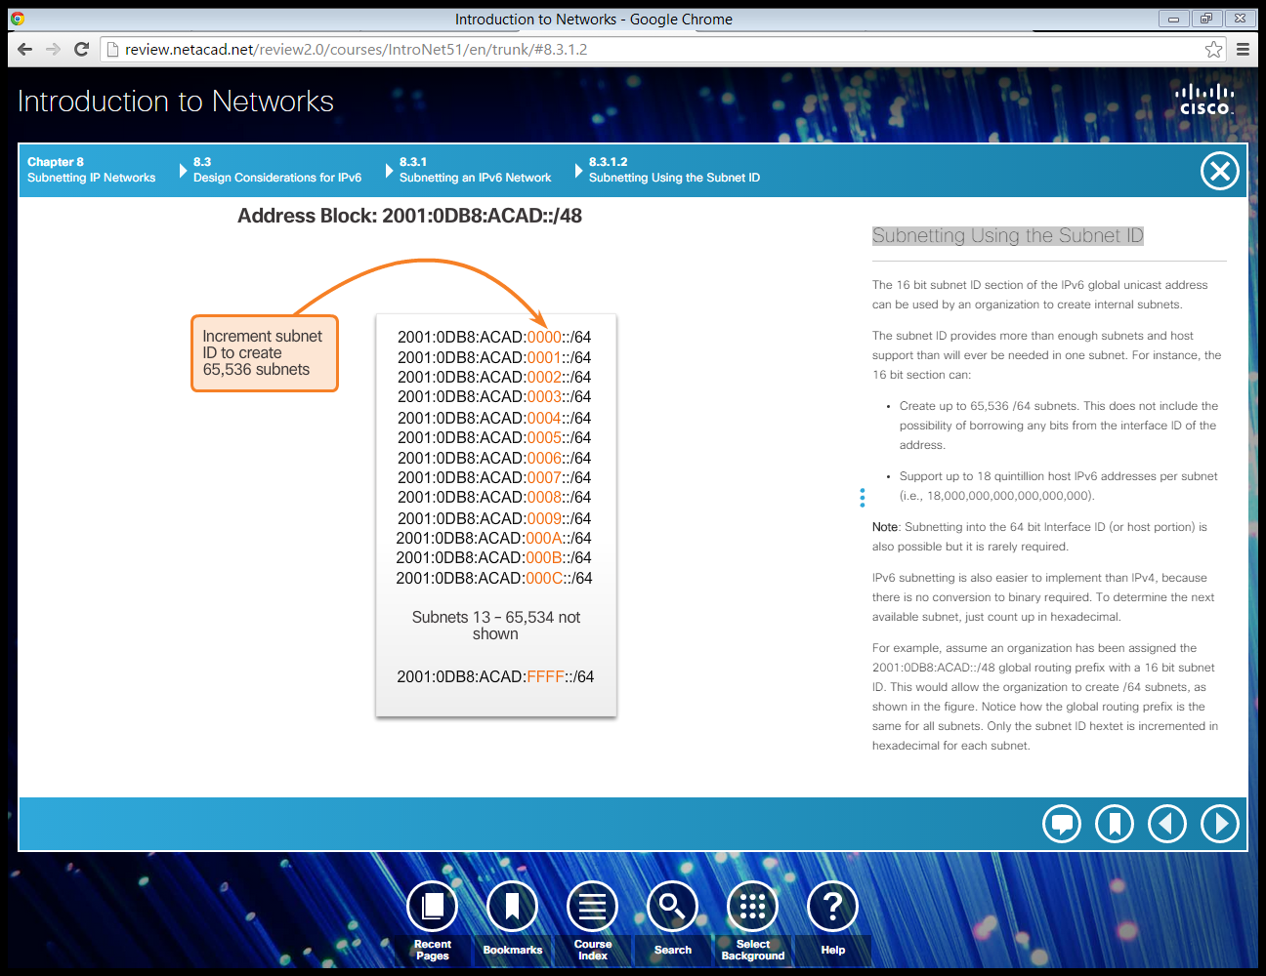
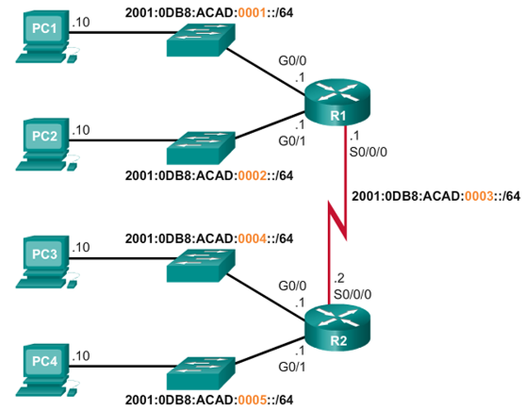
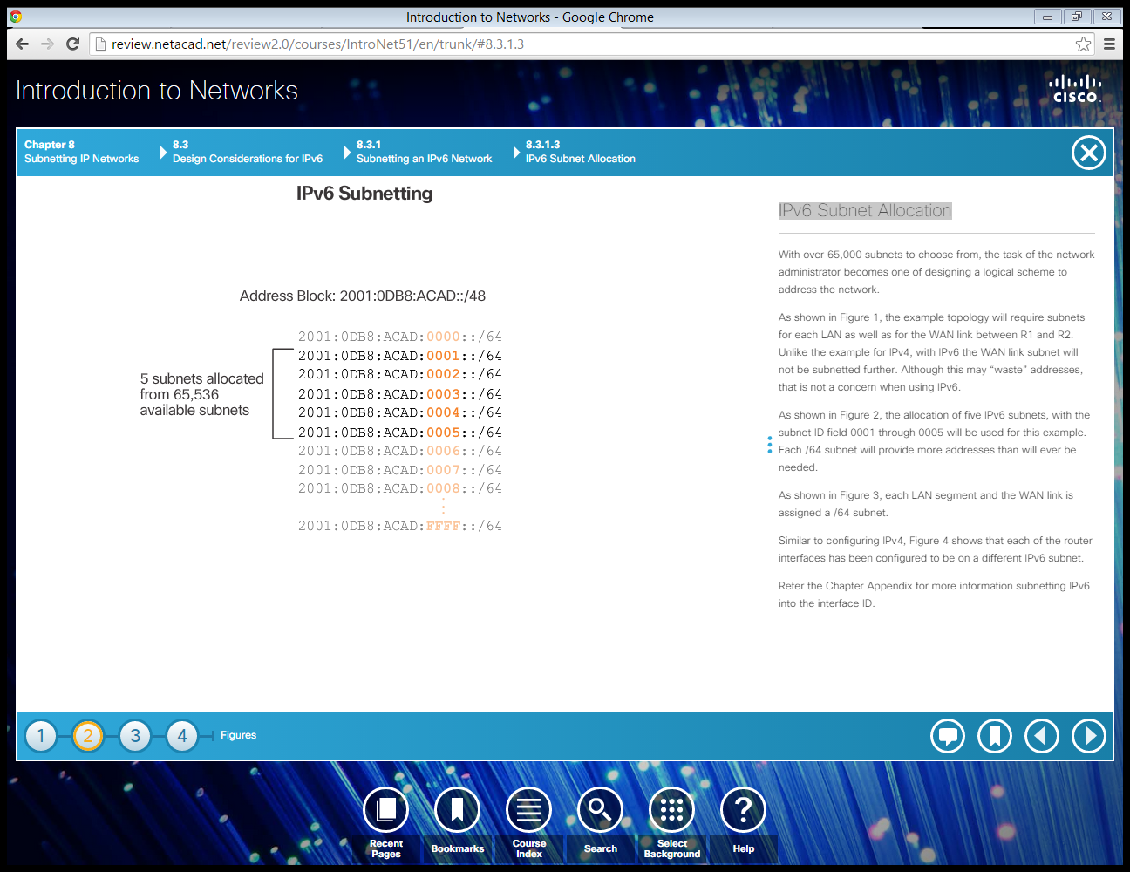
Subnetting Using the Subnet ID
IPv6 subnetting is also easier to implement than IPv4, because there is no conversion to binary required.
To determine the next available subnet, just count up in hexadecimal.
In this example, notice how the global routing prefix is the same for all subnets. Only the subnet ID hextet is incremented in hexadecimal for each subnet.

Slide 22
ICMP (Internet Control Message Protocol)
ICMP messages are used to provide feedback about issues related to the processing of IP packets, e.g. error reporting by an router.
ICMPv4 is the messaging protocol for IPv4. ICMPv6 provides these same services for IPv6 but includes additional functionality.
Common ICMP messages:
Host confirmation
An ICMP Echo Message can be used to determine if a host is operational. Host A sends an ICMP Echo Request to Host B. If the Host B is available, Host B responds with an Echo Reply.
This use of the ICMP Echo messages is the basis of the ping utility.
Destination or Service Unreachable
When a host or gateway receives a packet that it cannot deliver, it can use an ICMP Destination Unreachable message to notify the source that the destination or service is unreachable.
Time exceeded
Used by a router to indicate that an IPv4 packet cannot be forwarded because the Time to Live (TTL) field of the packet was decremented to 0.
If a router receives a packet and after it decrements the TTL field in the IPv4 packet by 1, the TTL field is zero, it discards the packet and sends a Time Exceeded message to the source.
Basis of the traceroute utility

Slide 23
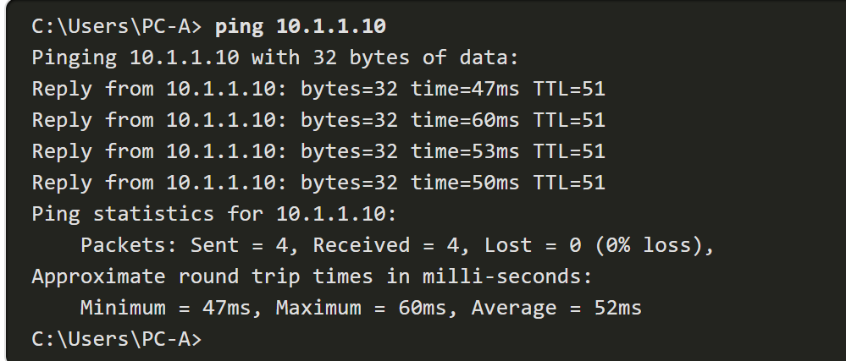
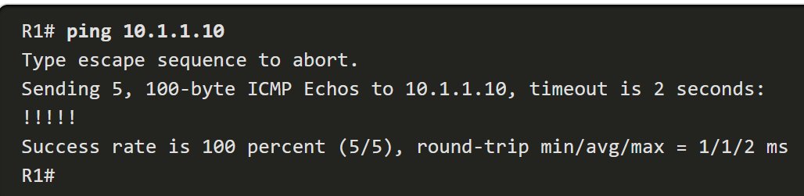
The ping command
The ping command uses Internet Control Message Protocol (ICMP) to verify Layer 3 connectivity.
An effective way to test connectivity
The ping command will not always pinpoint the nature of a problem, but it can help to identify the source of the problem, an important first step in troubleshooting a network failure.
On a Windows 10 host, the ping command sends four consecutive ICMP echo messages and expects four consecutive ICMP echo replies from the destination.
A Cisco IOS ping command output varies from a Windows host. For instance, the IOS ping sends five ICMP echo messages, as shown in the output.

Slide 24
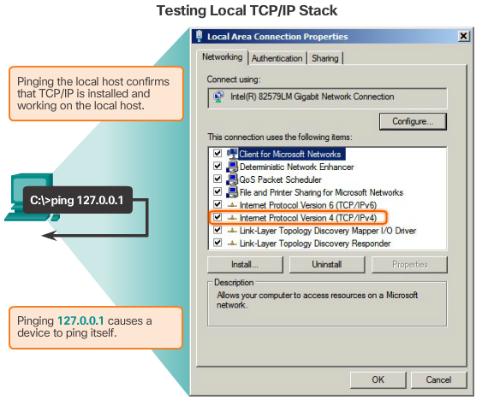
Ping - Testing the Local Stack
Ping can be used to test the internal configuration of IPv4 or IPv6 on the local host.
To perform this test, ping the local loopback address of 127.0.0.1 for IPv4 (::1 for IPv6).
A response from 127.0.0.1 for IPv4, or ::1 for IPv6, indicates that IP is properly installed on the host.
This response is not, however, an indication that the addresses, masks, or gateways are properly configured.

Slide 25
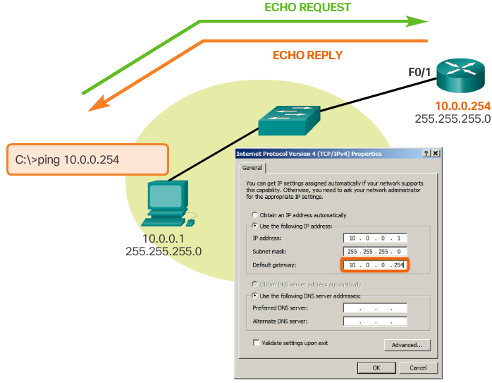
Ping –Testing Connectivity to the Local LAN
To test host’s connectivity to the local network, pinging to default gateway is most often used as the router is normally always operational.
If the gateway address does not respond, a ping can be sent to the IP address of another host on the local network known to be operational.
If either the gateway or another host responds, then the local host can successfully communicate over the local network.
If the gateway does not respond but another host does, this could indicate a problem with the router interface serving as the gateway.
One possibility is that the wrong gateway address has been configured on the host.
Another possibility is that the router interface may be fully operational but have security applied to it that prevents it from processing or responding to ping requests.

Slide 26
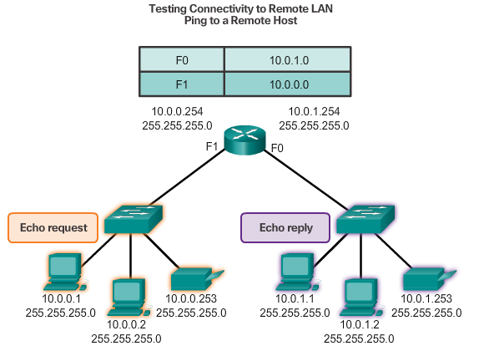
Ping – Testing Connectivity to Remote
If a ping to a remote host is successful, the operation of a large piece of the internetwork can be verified:
the operation of the router serving as the default gateway
the operation of all other routers that might be in the path between the local network and the network of the remote host.
the functionality of the remote host:
If the remote host could not communicate outside of its local network, it would not have responded.
Note: Many network administrators limit or prohibit the entry of ICMP messages into the corporate network; therefore, the lack of a ping response could be due to security restrictions.
The local host can ping an operational IPv4 host of a remote network, as shown in the figure: ping from 10.0.0.1 to 10.0.1.1. The router uses its IP routing table to forward the packets.

Slide 27
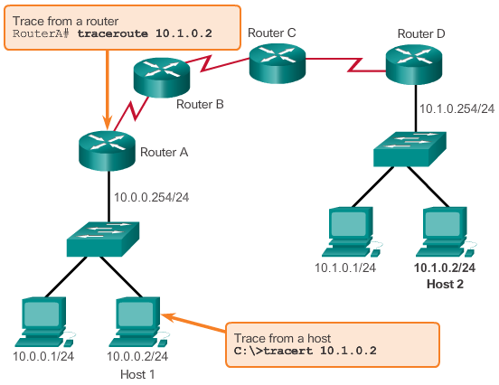
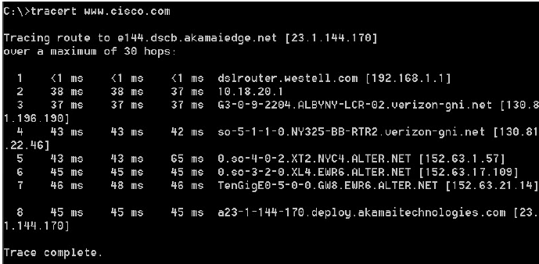
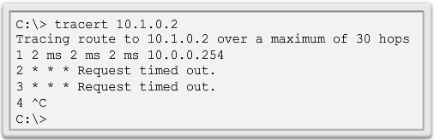
Tracert/ Traceroute – Testing the Path
Ping is used to test connectivity between two hosts but does not provide information about the details of devices between the hosts.
Tracert (windows based system) or Traceroute (Cisco IOS or Unix) is a utility that generates a list of hops that were successfully reached along the path.
If the data reaches the destination, then the trace lists the interface of every router in the path between the hosts.
If the data fails at some hop along the way, the address of the last router that responded to the trace can provide an indication of where the problem or security restrictions are found. An asterisk (*) is used to indicate a lost or unreplied packet
A successful trace to the destination www.cisco.com:
Where is the problem?

Slide 28
Traceroute – Testing the Path
Traceroute works by making use of
the TTL field in IPv4 and the Hop Limit field in IPv6 headers, and
the ICMP time exceeded message.
The first sequence of messages sent from traceroute have TTL = 1 → time out the IPv4 packet at the 1st router.
This router then responds with an ICMPv4 time exceeded message. Traceroute now has the address of the first hop.
Traceroute then progressively increments the TTL field (2, 3, 4...) for each sequence of messages.
This provides the trace with the address of each hop as the packets timeout further down the path.
The TTL field continues to be increased until the destination is reached, or it is incremented to a predefined maximum.
After the final destination is reached, the host responds with either an ICMP port unreachable message or an ICMP echo reply message

Slide 29

Traceroute – Testing the Path
Put mouse over the black box below, you will see the play button. Click the button to watch the video.

